Slide 1
Linear Regression & Case Study

Slide 2
Session outline
Supervised Learning Techniques
Introduction to Correlation and Regression
Correlation and Regression using Python
Classification and Regression models
Linear Regression
Python implementation of Linear regression

Slide 3
Supervised Learning Techniques
Supervised learning is the types of machine learning in which machines are trained using well "labelled" training data, and on basis of that data, machines predict the output.
The labelled data means some input data is already tagged with the correct output.
In supervised learning, the training data provided to the machines work as the supervisor that teaches the machines to predict the output correctly.
It applies the same concept as a student learns in the supervision of the teacher.
Supervised learning is a process of providing input data as well as correct output data to the machine learning model.
The aim of a supervised learning algorithm is to find a mapping function to map the input variable(x) with the output variable(y)

Slide 4
In the real-world, supervised learning can be used for
Risk Assessment
Image classification
Fraud Detection
spam filtering

Slide 5
How Supervised Learning Works?
In supervised learning, models are trained using labelled dataset, where the model learns about each type of data.
Once the training process is completed, the model is tested on the basis of test data (a subset of the training set), and then it predicts the output.
The working of Supervised learning can be easily understood by the below example and diagram:

Slide 6
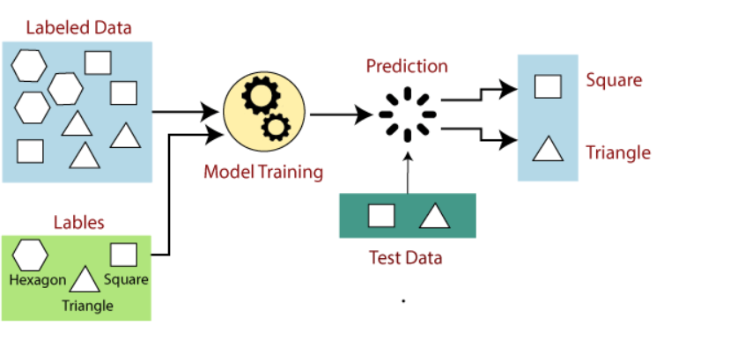

Slide 7
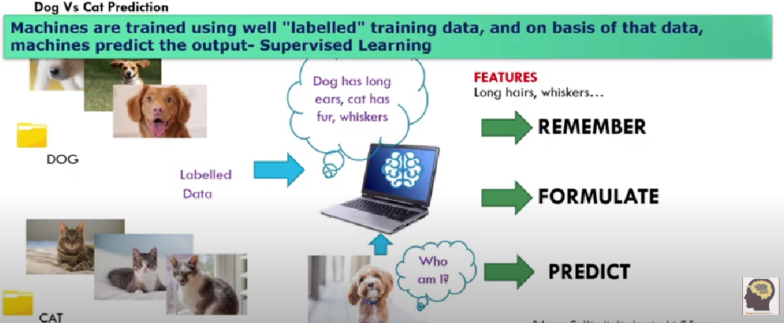
Supervised Learning

Slide 8
Suppose we have a dataset of different types of shapes which includes square, rectangle, triangle, and Polygon. Now the first step is that we need to train the model for each shape.
If the given shape has four sides, and all the sides are equal, then it will be labelled as a Square.
If the given shape has three sides, then it will be labelled as a triangle.
If the given shape has six equal sides then it will be labelled as hexagon.
Now, after training, we test our model using the test set, and the task of the model is to identify the shape.
The machine is already trained on all types of shapes, and when it finds a new shape, it classifies the shape on the bases of a number of sides, and predicts the output.

Slide 9
Steps Involved in Supervised Learning:
First Determine the type of training dataset
Collect/Gather the labelled training data.
Split the training dataset into training dataset, test dataset, and validation dataset.
Determine the input features of the training dataset, which should have enough knowledge so that the model can accurately predict the output.
Determine the suitable algorithm for the model, such as support vector machine, decision tree, etc.
Execute the algorithm on the training dataset. Sometimes we need validation sets as the control parameters, which are the subset of training datasets.
Evaluate the accuracy of the model by providing the test set. If the model predicts the correct output, which means our model is accurate.

Slide 10
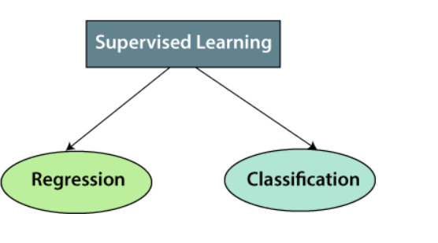
Types of supervised Machine learning Algorithms:

Slide 11
1. Regression
Regression algorithms are used if there is a relationship between the input variable and the output variable. It is used for the prediction of continuous variables, such as Weather forecasting, Market Trends, etc.
Below are some popular Regression algorithms which come under supervised learning:
Linear Regression
Regression Trees
Non-Linear Regression
Bayesian Linear Regression
Polynomial Regression

Slide 12
2. Classification
Classification algorithms are used when the output variable is categorical, which means there are two classes such as Yes-No, Male-Female, True-false, etc.
Spam Filtering,
Random Forest
Decision Trees
Logistic Regression
Support vector Machines

Slide 13
Advantages of Supervised learning:
With the help of supervised learning, the model can predict the output on the basis of prior experiences.
In supervised learning, we can have an exact idea about the classes of objects.
Supervised learning model helps us to solve various real-world problems such as fraud detection, spam filtering, etc.

Slide 14
Disadvantages of supervised learning:
Supervised learning models are not suitable for handling the complex tasks.
Supervised learning cannot predict the correct output if the test data is different from the training dataset.
Training required lots of computation times.
In supervised learning, we need enough knowledge about the classes of object.

Slide 15
Correlation Analysis
Correlation analysis is a statistical method used to measure the strength of the linear relationship between two variables and compute their association.
Correlation analysis calculates the level of change in one variable due to the change in the other.
A high correlation points to a strong relationship between the two variables, while a low correlation means that the variables are weakly related.
Researchers use correlation analysis to analyze quantitative data collected through research methods like surveys and live polls for market research.
They try to identify relationships, patterns, significant connections, and trends between two variables or datasets.
There is a positive correlation between two variables when an increase in one variable leads to an increase in the other.
On the other hand, a negative correlation means that when one variable increases, the other decreases and vice-versa.

Slide 16
Correlation is a bivariate analysis that measures the strength of association between two variables and the direction of the relationship.
In terms of the strength of the relationship, the correlation coefficient's value varies between +1 and -1.
A value of ± 1 indicates a perfect degree of association between the two variables.
As the correlation coefficient value goes towards 0, the relationship between the two variables will be weaker.
The coefficient sign indicates the direction of the relationship; a + sign indicates a positive relationship, and a - sign indicates a negative relationship.

Slide 17
Regression
Regression analysis is a statistical method to model the relationship between a dependent (target) and independent (predictor) variables with one or more independent variables.
More specifically, Regression analysis helps us to understand how the value of the dependent variable is changing corresponding to an independent variable when other independent variables are held fixed.
It predicts continuous/real values such as temperature, age, salary, price, etc.
Suppose there is a marketing company A, who does various advertisement every year and get sales on that.
The below list shows the advertisement made by the company in the last 5 years and the corresponding sales:

Slide 18
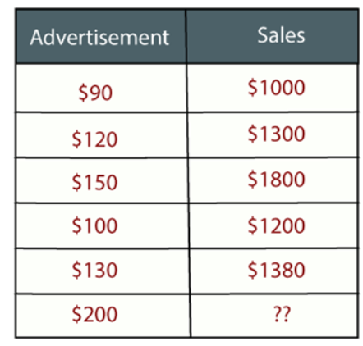

Slide 19
Now, the company wants to do the advertisement of $200 in the year 2019 and wants to know the prediction about the sales for this year.
So to solve such type of prediction problems in machine learning, we need regression analysis.
Regression is a supervised learning technique which helps in finding the correlation between variables and enables us to predict the continuous output variable based on the one or more predictor variables.
It is mainly used for prediction, forecasting, time series modeling, and determining the causal-effect relationship between variables.

Slide 20
In Regression, we plot a graph between the variables which best fits the given datapoints, using this plot, the machine learning model can make predictions about the data.
In simple words, "Regression shows a line or curve that passes through all the datapoints on target-predictor graph in such a way that the vertical distance between the datapoints and the regression line is minimum."
The distance between datapoints and line tells whether a model has captured a strong relationship or not.
Some examples of regression can be as:
Prediction of rain using temperature and other factors
Determining Market trends
Prediction of road accidents due to rash driving.

Slide 21
Terminologies Related to the Regression Analysis:
Dependent Variable: The main factor in Regression analysis which we want to predict or understand is called the dependent variable. It is also called target variable.
Independent Variable: The factors which affect the dependent variables or which are used to predict the values of the dependent variables are called independent variable, also called as a predictor.
Outliers: Outlier is an observation which contains either very low value or very high value in comparison to other observed values. An outlier may hamper the result, so it should be avoided.
Multicollinearity: If the independent variables are highly correlated with each other than other variables, then such condition is called Multicollinearity. It should not be present in the dataset, because it creates problem while ranking the most affecting variable.
Underfitting and Overfitting: If our algorithm works well with the training dataset but not well with test dataset, then such problem is called Overfitting. And if our algorithm does not perform well even with training dataset, then such problem is called underfitting.

Slide 22
Regression vs. Classification in Machine Learning
Regression and Classification algorithms are Supervised Learning algorithms.
Both the algorithms are used for prediction in Machine learning and work with the labeled datasets.
But the difference between both is how they are used for different machine learning problems.
The main difference between Regression and Classification algorithms that Regression algorithms are used to predict the continuous values such as price, salary, age, etc.
And Classification algorithms are used to predict/Classify the discrete values such as Male or Female, True or False, Spam or Not Spam, etc.

Slide 23
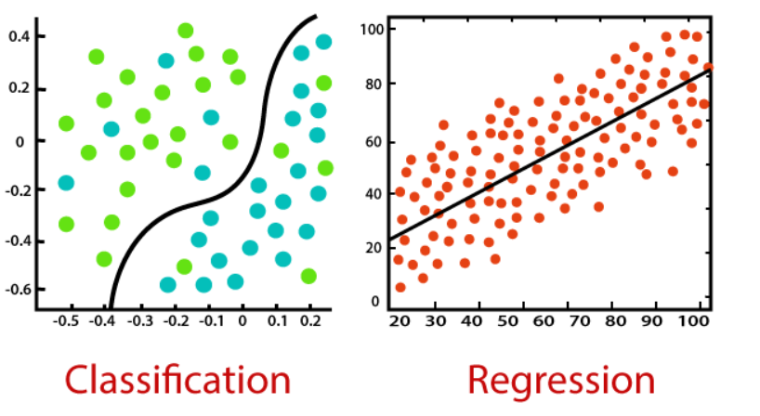

Slide 24
Classification:
Classification is a process of finding a function which helps in dividing the dataset into classes based on different parameters.
In Classification, a computer program is trained on the training dataset and based on that training, it categorizes the data into different classes.
The task of the classification algorithm is to find the mapping function to map the input(x) to the discrete output(y).
Example: The best example to understand the Classification problem is Email Spam Detection.
The model is trained on the basis of millions of emails on different parameters, and whenever it receives a new email, it identifies whether the email is spam or not.
If the email is spam, then it is moved to the Spam folder.

Slide 25
Types of ML Classification Algorithms:
Classification Algorithms can be further divided into the following types:
Logistic Regression
K-Nearest Neighbours
Support Vector Machines
Kernel SVM
Naïve Bayes
Decision Tree Classification
Random Forest Classification

Slide 26
Regression:
Regression is a process of finding the correlations between dependent and independent variables.
It helps in predicting the continuous variables such as prediction of Market Trends, prediction of House prices, etc.
The task of the Regression algorithm is to find the mapping function to map the input variable(x) to the continuous output variable(y).
Example: Suppose we want to do weather forecasting, so for this, we will use the Regression algorithm.
In weather prediction, the model is trained on the past data, and once the training is completed, it can easily predict the weather for future days.

Slide 27
Types of Regression Algorithm:
Simple Linear Regression
Multiple Linear Regression
Polynomial Regression
Support Vector Regression
Decision Tree Regression
Random Forest Regression

Slide 28
Difference between Regression and Classification
Regression Algorithm | Classification Algorithm
In Regression, the output variable must be of continuous nature or real value. | In Classification, the output variable must be a discrete value.
The task of the regression algorithm is to map the input value (x) with the continuous output variable(y). | The task of the classification algorithm is to map the input value(x) with the discrete output variable(y).
Regression Algorithms are used with continuous data. | Classification Algorithms are used with discrete data.
In Regression, we try to find the best fit line, which can predict the output more accurately. | In Classification, we try to find the decision boundary, which can divide the dataset into different classes.
Regression algorithms can be used to solve the regression problems such as Weather Prediction, House price prediction, etc. | Classification Algorithms can be used to solve classification problems such as Identification of spam emails, Speech Recognition, Identification of cancer cells, etc.
The regression Algorithm can be further divided into Linear and Non-linear Regression. | The Classification algorithms can be divided into Binary Classifier and Multi-class Classifier.

Slide 29
Linear Regression in Machine Learning
Linear regression is one of the easiest and most popular Machine Learning algorithms.
It is a statistical method that is used for predictive analysis. Linear regression makes predictions for continuous/real or numeric variables such as sales, salary, age, product price, etc.
Linear regression algorithm shows a linear relationship between a dependent (y) and one or more independent (y) variables, hence called as linear regression.
Since linear regression shows the linear relationship, which means it finds how the value of the dependent variable is changing according to the value of the independent variable.
The linear regression model provides a sloped straight line representing the relationship between the variables.
Consider the below image:

Slide 30
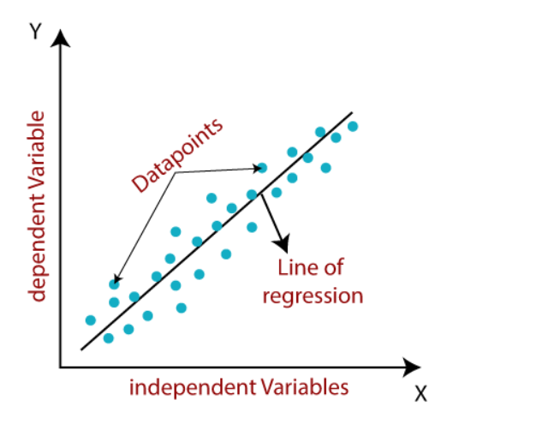

Slide 31
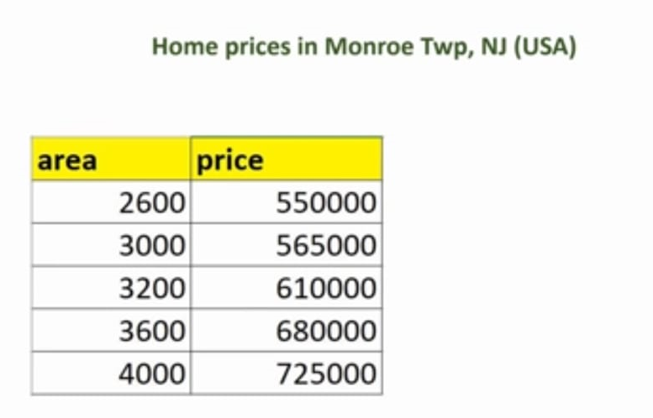

Slide 32
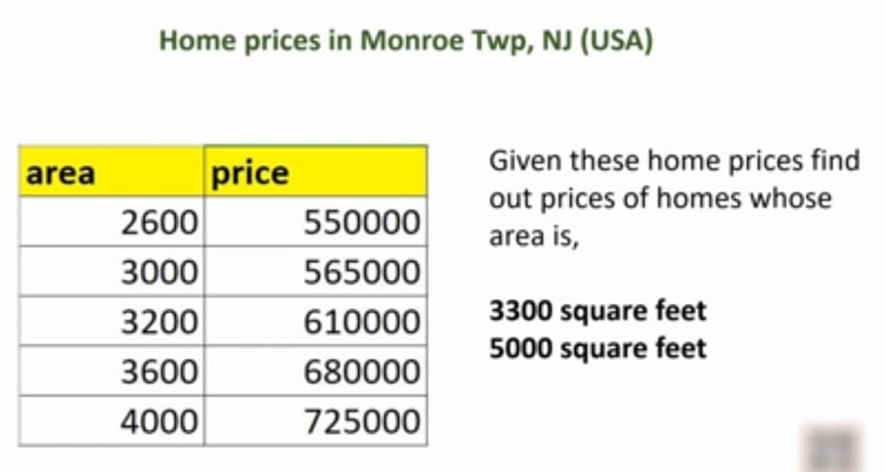

Slide 33
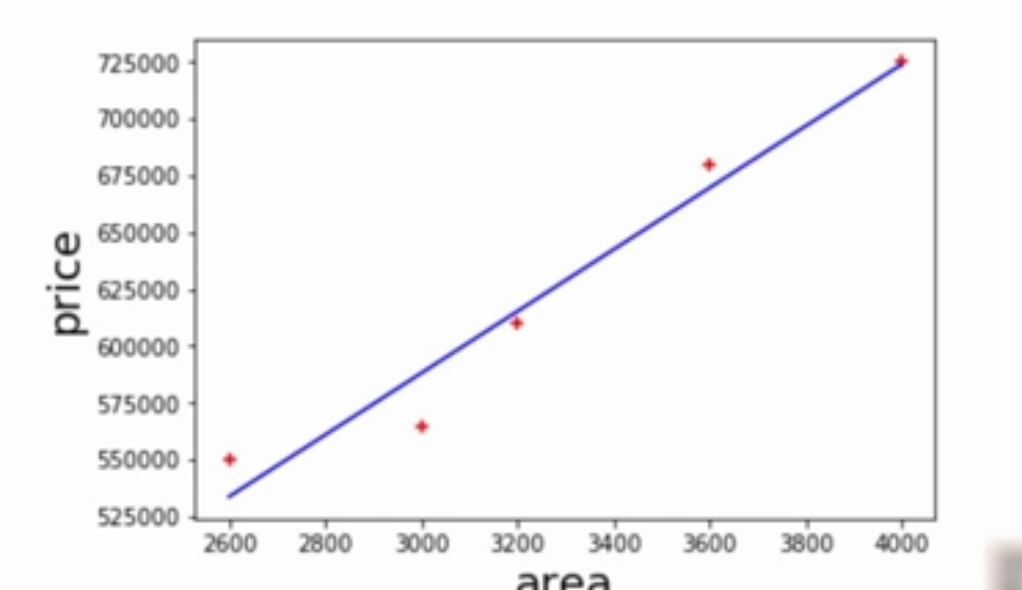

Slide 34
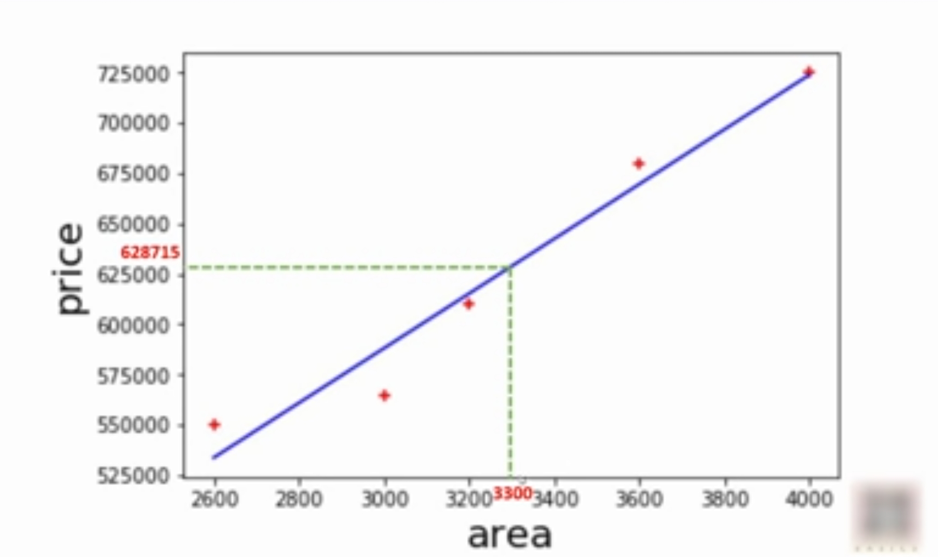

Slide 35
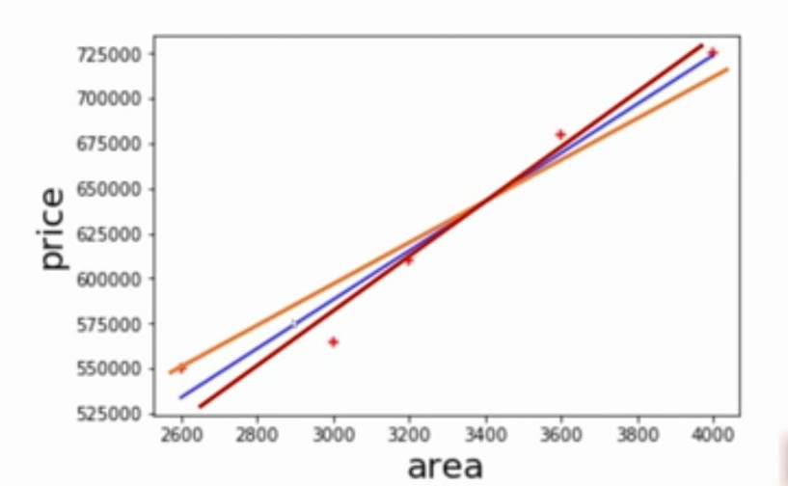

Slide 36
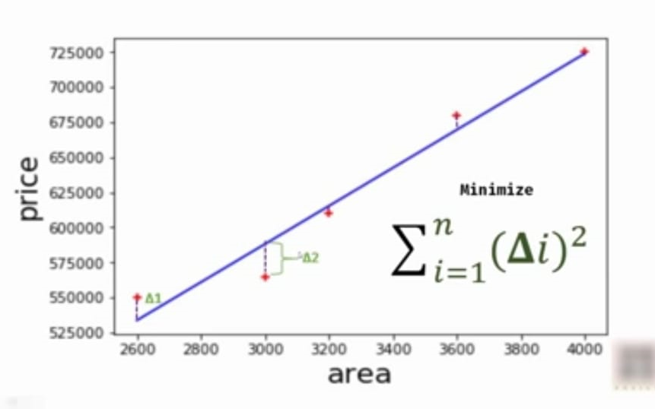

Slide 37
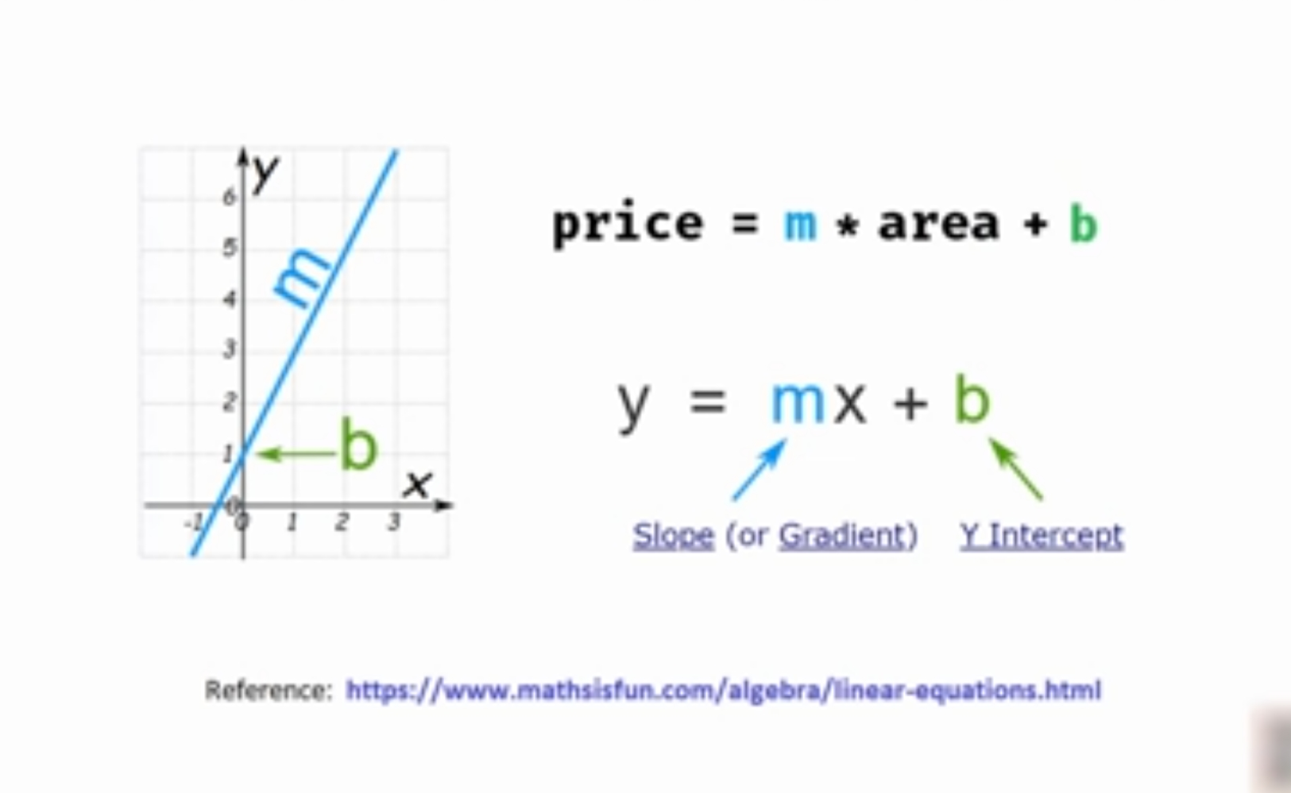

Slide 38
